Slide 1
Client server
Layout, Menu & Intent - Pertemuan 3

Slide 2
Layout

Slide 3



Slide 4
Layout
FrameLayout
LinearLayout
TableLayout
TableRow
GridLayout
RelativeLayout

Slide 5
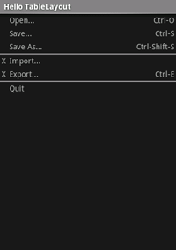
Table layouts
Table Layout
Like the HTML div tag
/* table.xml */
<?xml version=“1.0” encoding=“utf-8”?>
<TableLayout android:layout_width=“fill_parent”
android:layout_height=“fill_parent”
android:stretchColumns=“1”> <TableRow> <TextView android:layout_column=“1”
android:text=“Open...”
android:padding=“3dip” />
<TextView android:text=“Ctrl-O”
android:gravity=“right”
android:padding=“3dip” />
</TableRow>
</TableLayout>

Slide 6
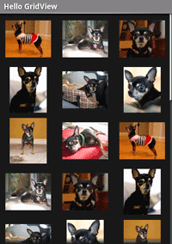
Grid View
Grid View
/* grid.xml */
<?xml version=“1.0” encoding=“utf-8”?>
<GridView
android:id=“@+id/gridview” android:layout_width=“fill_parent” android:layout_height=“fill_parent” android:columnWidth=“90dp” android:numColumns=“auto_fit”
android:verticalSpacing=“10dp” android:horizontalSpacing=“10dp”
android:stretchMode=“columnWidth” android:gravity=“center”
/>

Slide 7
Grid View
Grid View
/* GridExample.java */
public void onCreate(Bundle savedInstanceState) {
super.onCreate(savedInstanceState); setContentView(R.layout.grid); GridView gridview = (GridView) findViewById(R.id.gridview); gridview.setAdapter(new AdapterForGridView(this)); gridview.setOnItemClickListener(
new OnItemClickListener() { public void onItemClick(AdapterView<?> parent, View v,
int pos, long id) {
Toast.makeText(
GridPrimer.this, "" + pos, Toast.LENGTH_SHORT).show(); }});
}

Slide 8
Grid View
Grid View
/* AdapterForGridView.java */
public class AdapterForGridView extends BaseAdapter {
private Context mContext; public AdapterForGridView(Context c) { mContext = c; } public int getCount() { return mThumbIDs.length; } public Object getItem(int position) { return null;} public long getItemId(int position) { return 0; }
// bad getView implementation
public View getView(int pos, View convertView, ViewGroup parent) { ImageView imageView = new ImageView(mContext); imageView.setImageResource(mThumbIDs[pos]); return imageView;
} private Integer[] mThumbIDs =
{ R.drawable.img1, R.drawable.img2 /*...*/ };
}

Slide 9
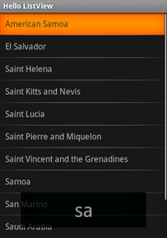
List View
List View
/* list_item.xml */
<?xml version=“1.0” encoding=“utf-8”?>
<TextView
android:layout_width=“fill_parent”
android:layout_height=“fill_parent”
android:padding=“10dp”
android:textSize=“16sp” />

Slide 10
List View
List View
/* ListViewExample.java */
public class ListViewExample extends ListActivity {
@Override
public void onCreate(Bundle savedInstanceState) { super.onCreate(savedInstanceState);
setListAdapter(new ArrayAdapter<String>(this, R.layout.list_item, COUNTRIES));
ListView lv = getListView();
lv.setTextFilterEnabled(true);
lv.setOnItemClickListener(new OnItemClickListener() { public void onItemClick(AdapterView<?> parent, View view, int position, long id) { Toast.makeText(getApplicationContext(),
((TextView) view).getText(), Toast.LENGTH_SHORT).show();
}});
}

Slide 11
Menu

Slide 12
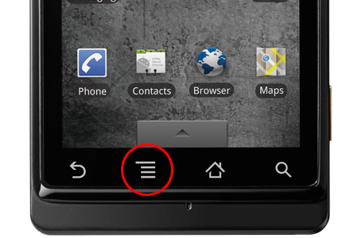
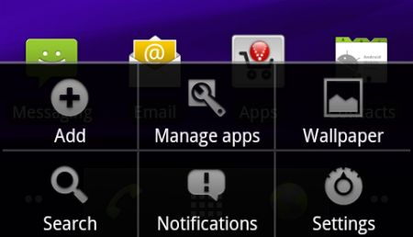

History
Beginning with Android 3.0 (API level 11), Android-powered devices are no longer required to provide a dedicated Menu button

Slide 13
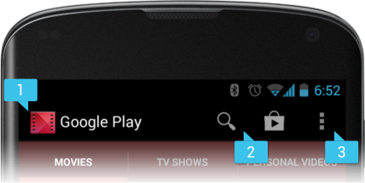
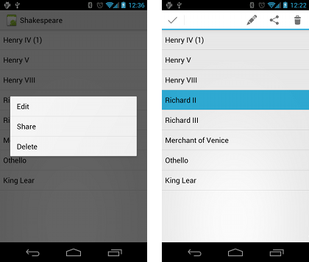
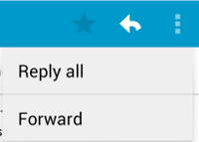
Types of Menus
http://developer.android.com/guide/topics/ui/menus.html
Three fundamental types of menus
Options menu and action bar
Context menu and contextual action mode
Popup menu

Slide 14
Intent

Slide 15
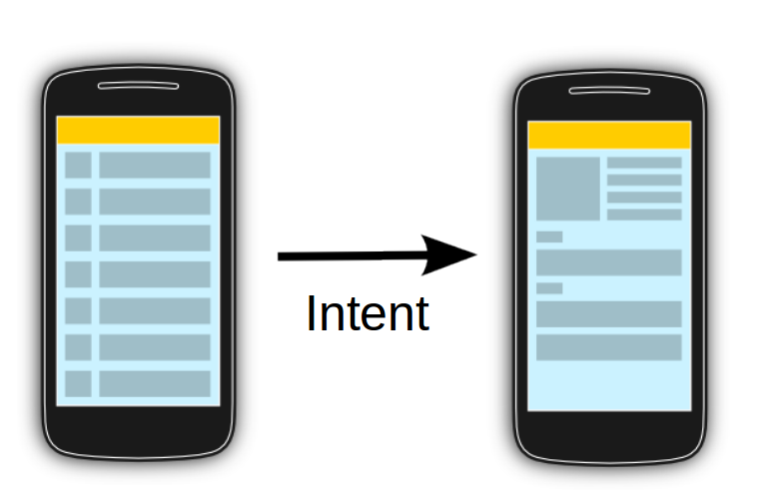
Intent
Allows communication between components
Message passing
Bundle
Activity 1
Activity 2

Slide 16
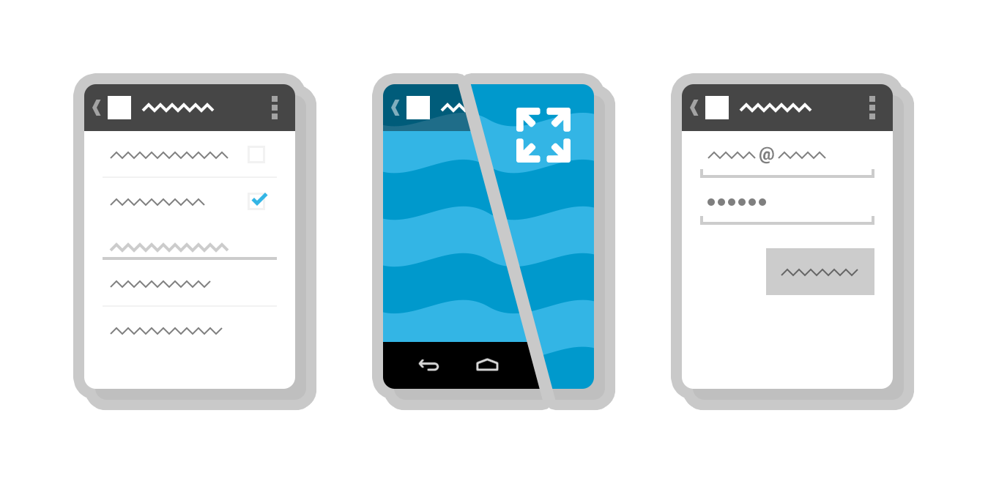
Intent
Three fundamental use-cases of Intent :
To start an activity
startActivity()
startActivityForResult()
To start a service
startService()
bindService()
To deliver a broadcast
sendBroadcast(),
sendOrderedBroadcast(), or
sendStickyBroadcast()

Slide 17
Intent Types

Slide 18
Explicit Intent
Implicit Intent
Intent Types

Slide 19
Explicit Intent

Slide 20
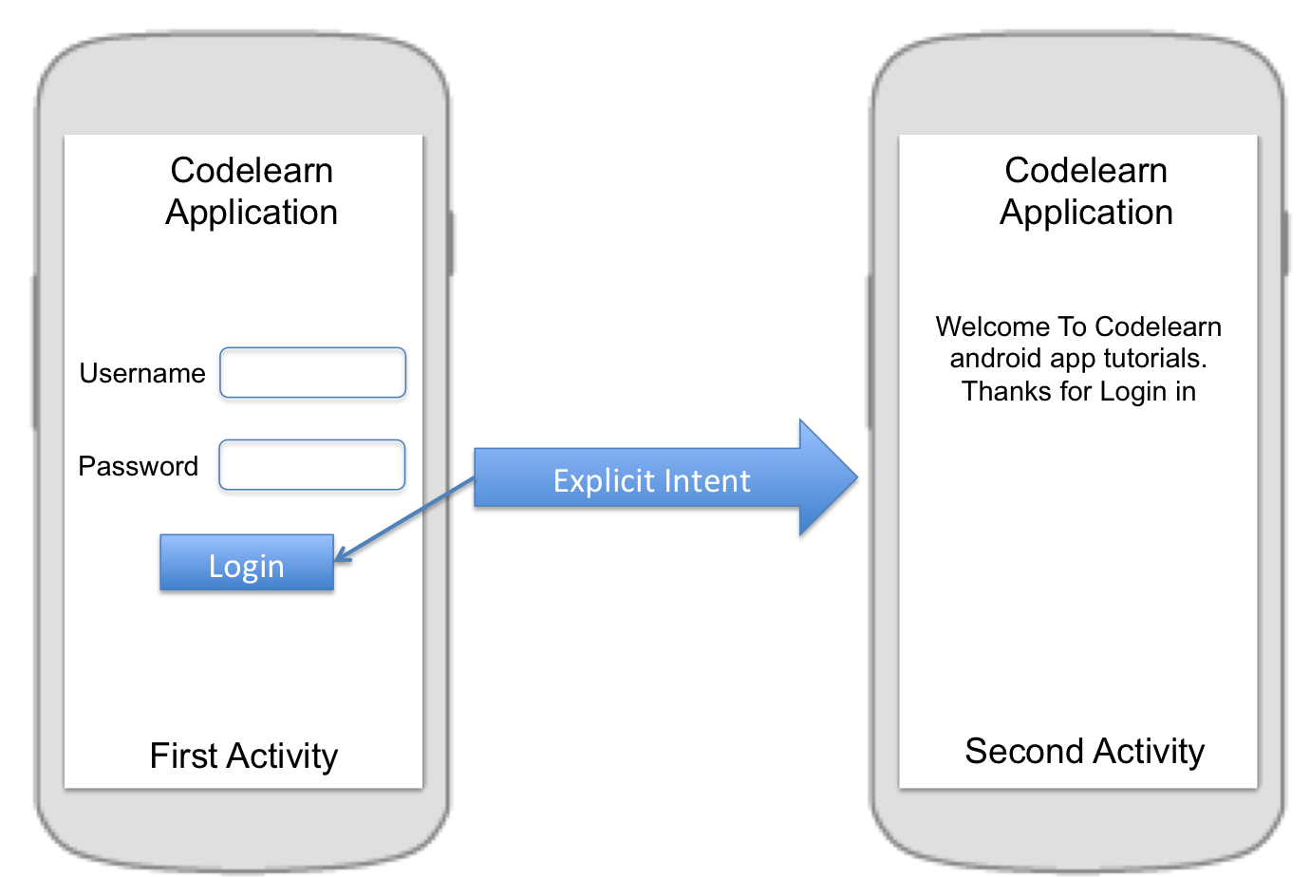
Intent intent = new Intent(FirstActivity.this, SecondActivity.class);
startActivity(intent);
Intent intent = new Intent(FirstActivity.this, SecondActivity.class);
intent.putExtra("Value1", "This value one for ActivityTwo ");
intent.putExtra("Value2", "This value two ActivityTwo");
startActivity(intent);

Slide 21
@Override
public void onCreate(Bundle savedInstanceState) {
super.onCreate(savedInstanceState);
setContentView(R.layout.main);
// Button listener
Button btnStart = (Button) findViewById(R.id.btn_start);
btnStart.setOnClickListener(new View.OnClickListener() {
public void onClick(View view) {
Intent intent =
new Intent(FirstActivity.this, SecondActivity.class);
startActivity(intent);
}
});
}

Slide 22
Implicit Intent

Slide 23
Implicit Intent
This type of intent is called an implicit intent because it does not specify the app component to start, but instead specifies an action and provides some data with which to perform the action.

Slide 24
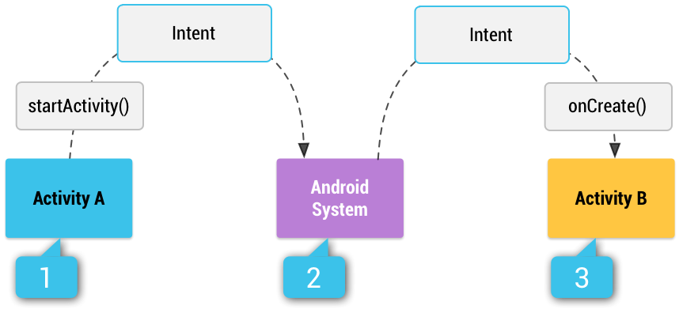
How an implicit intent is delivered through the system to start another activity

Slide 25
Activity A creates an Intent with an action description and passes it to startActivity().
The Android System searches all apps for an intent filter that matches the intent. When a match is found,
the system starts the matching activity (Activity B) by invoking its onCreate() method and passing it the Intent.

Slide 26
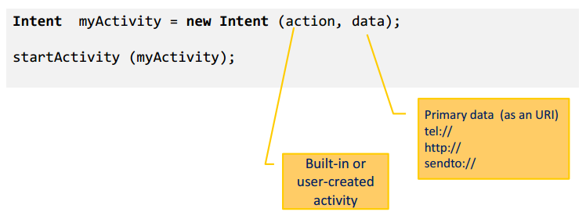
Implicit Intent Structure
The main arguments of an Intent are:
Action : The built-in action to be performed, such as ACTION_VIEW, ACTION_EDIT, ACTION_MAIN, …or user-created-activity
Data : The primary data to operate on, such as a phone number to be called (expressed as a Uri)

Slide 27
Intent Data Example
Action | Data
ACTION_DIAL | tel:081298419869
ACTION_CALL | tel:081298419869
ACTION_VIEW | http://www.diploma.ipb.ac.id
ACTION_VIEW | geo:-6.590056,106.80581499999994 ?z=19
ACTION_EDIT | content://contacts/people/2
ACTION_VIEW | content://contacts/people/
http://developer.android.com/guide/components/intents-common.html

Slide 28







Common Intent
Alarm Clock
Calendar
Camera
Contacts/People App
Email
File Storage
Maps
Music or Video
Phone
Settings
Text Messaging
Web Browser
http://developer.android.com/guide/components/intents-common.html

Slide 29
Manifest Permission
Action | Permission
PHONE CALL | android.permission.CALL_PHONE
ALARM | com.android.alarm.permission.SET_ALARM
INTERNET | android.permission.INTERNET
CALENDAR | android.permission.READ_CALENDAR
CONTACT | android.permission.READ_CONTACTS
CAMERA | android.permission.CAMERA
SMS | android.permission.READ_SMS android.permission.SEND_SMS
http://developer.android.com/reference/android/Manifest.permission.html

Slide 30
Thank you
Andika Sundawijaya
sundawijaya@gmail.com

